Slide 1
Paris Olympics SQL Project
NIKHIL JAISWAL

Slide 2
1. Introduction
The Paris Olympics SQL Project is aimed at analyzing Olympic medalists' data, team performances, and overall medal counts using SQL. The project involves processing and querying datasets to derive insights into country-wise performance, athlete statistics, and trends in medal distribution.

Slide 3
2. Datasets Used
medallists.csv – Contains details of individual medalists, including athlete names, events, and countries.
medals_total.csv – Represents total medal counts by country.
teams.csv – Lists participating teams and their respective details.

Slide 4
3. Database Schema The project consists of the following tables: medallists
Column Name | Data Type | Description
athlete_id | INT | Unique identifier for the athlete
name | TEXT | Name of the athlete
country | TEXT | Country represented
sport | TEXT | Sport category
event | TEXT | Specific event
medal | TEXT | Type of medal (Gold, Silver, Bronze)

Slide 5
medals_total
Column Name | Data Type | Description
country | TEXT | Name of the country
gold | INT | Count of gold medals won
silver | INT | Count of silver medals won
bronze | INT | Count of bronze medals won
total | INT | Total medals won

Slide 6
teams
Column Name | Data Type | Description
team_id | INT | Unique identifier for the team
country | TEXT | Country represented
sport | TEXT | Sport category

Slide 7
4. SQL Queries Here are some key SQL queries used in the project:
1. Retrieve top 10 countries by total medals:
SELECT country, total FROM medals_total ORDER BY total DESCLIMIT 10;
2. Count of medalists per country:
SELECT country, COUNT(athlete_id) AS num_medalists FROM medallists GROUP BY country ORDER BY num_medalists DESC;
3. Athletes who won gold medals in a specific sport:
SELECT name, country, sport, event FROM medallists WHERE medal = 'Gold' AND sport = 'Athletics';

Slide 8
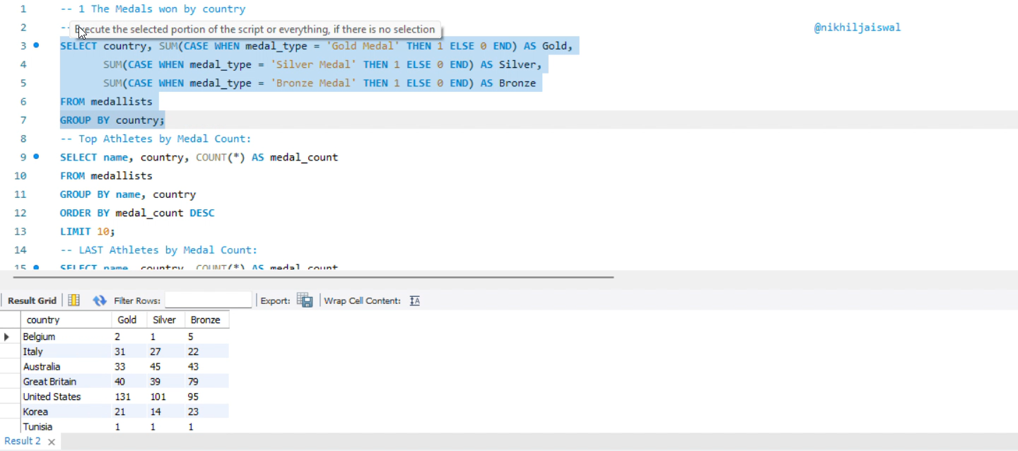
SQL Queries IN WORKBENCH

Slide 9
5. Insights and Conclusion
The top-performing countries in terms of total medals can be identified easily.
The distribution of gold, silver, and bronze medals gives insights into dominant nations in different sports.
The most successful athletes across various sports can be tracked.
Further analysis can help in predicting medal trends for future Olympics.

Slide 10
6. Future Enhancements
Incorporate historical Olympic data for trend analysis.
Use SQL joins to merge athlete and team data for deeper insights.
Develop visual dashboards to present the data interactively.

